Slide 1
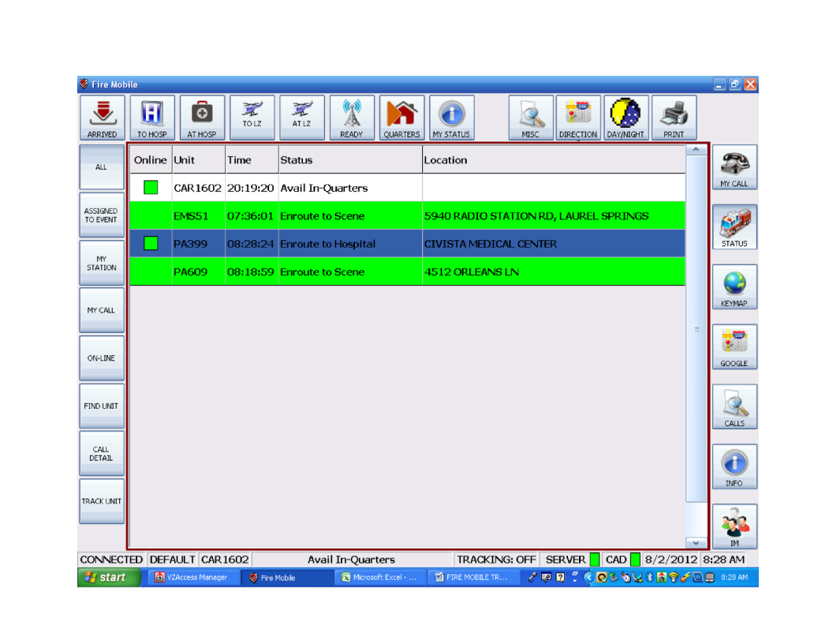
Introduction
Buttons on the left change as you change major functions
Buttons on the right are available at all times and are used to navigate to major functions
Buttons on the top are available at all times
Green = connected
Red/Yellow = problem.
Restart FM if server is not green.
Unit/MDT Name
Unit/MDT Status
This is the default screen – it is the first screen shown when you open the program.

Slide 2
Top Menu Bar
Use these buttons to change your status. IN ADDITION, YOU MUST CONTINUE TO USE THE RADIO. Select the appropriate button and then tell the dispatcher what you’re doing. If you press the wrong button, you must tell the dispatcher.
Only dispatchers can put you Enroute to an incident.

Slide 3
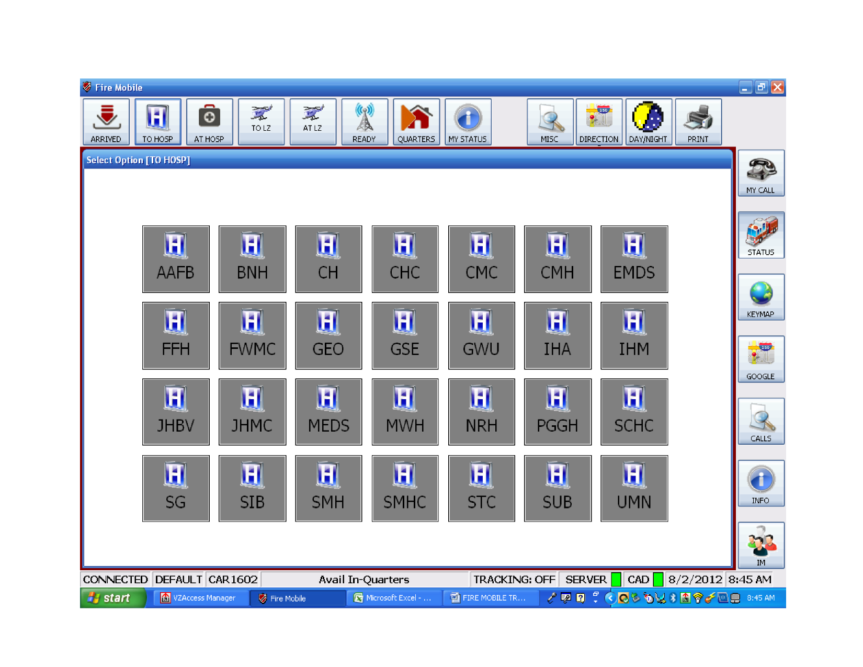
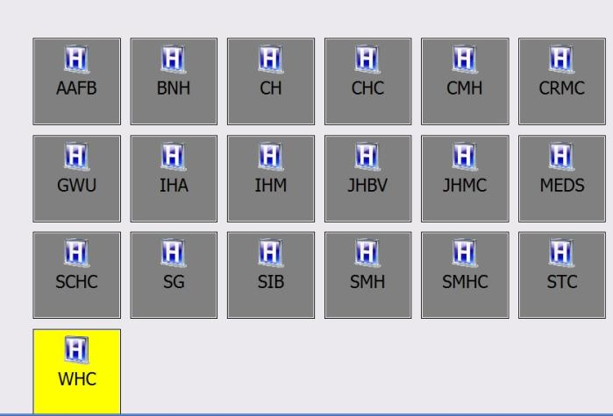
Enroute to Hospital Screen
Choose the hospital that you are transporting to.
Hospital status color is displayed on the button if applicable.

Slide 4
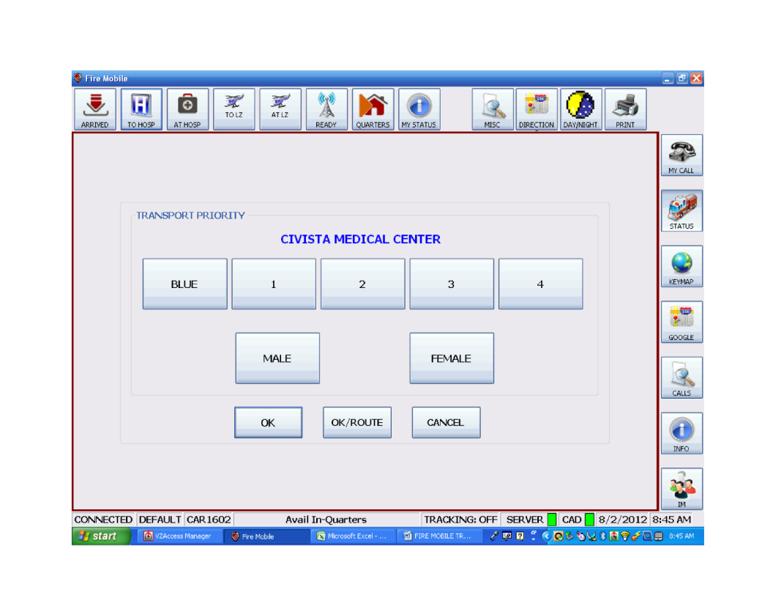

Enroute to Hospital Screen
Choose Priority
Choose Gender
Complete patient transport info
Complete patient transport info and get a Google Map route to the hospital you selected
Cancels the transport data

Slide 5
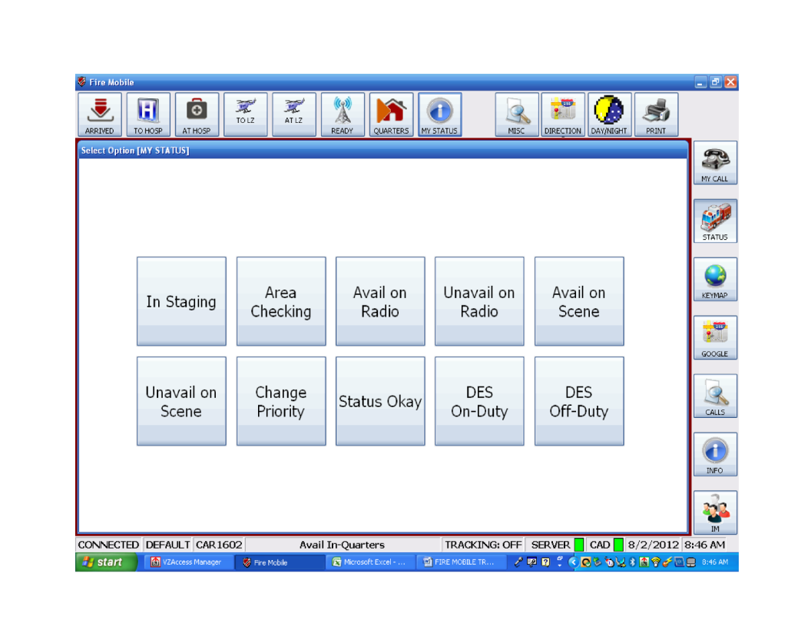

MY STATUS Button
You must contact the dispatcher to put units IN or OUT OF SERVICE.
Please do not use these buttons. They are only used to take DoES ALS Units (Ch16, Ch16A, Car1608, Car1609) OFF DUTY.
Used to select a status not located on the top bar

Slide 6
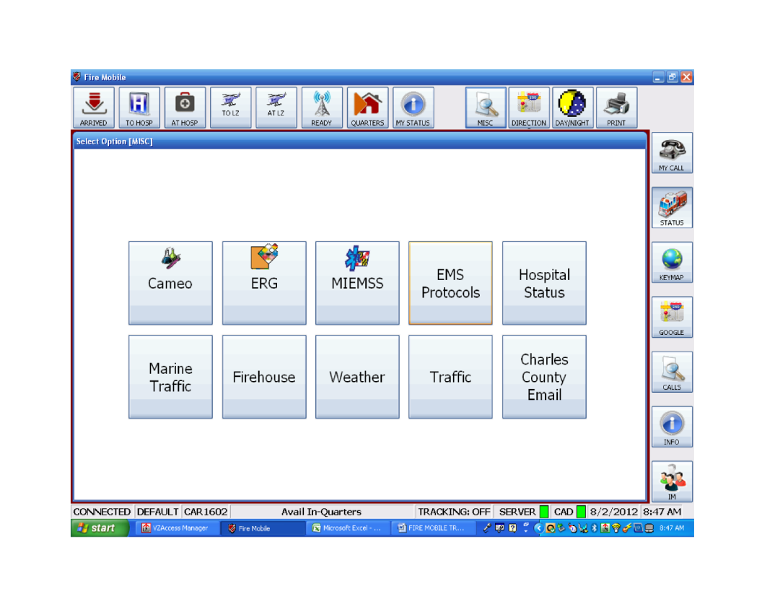

MISC Button
Use these buttons to access predetermined internet sites.

Slide 7
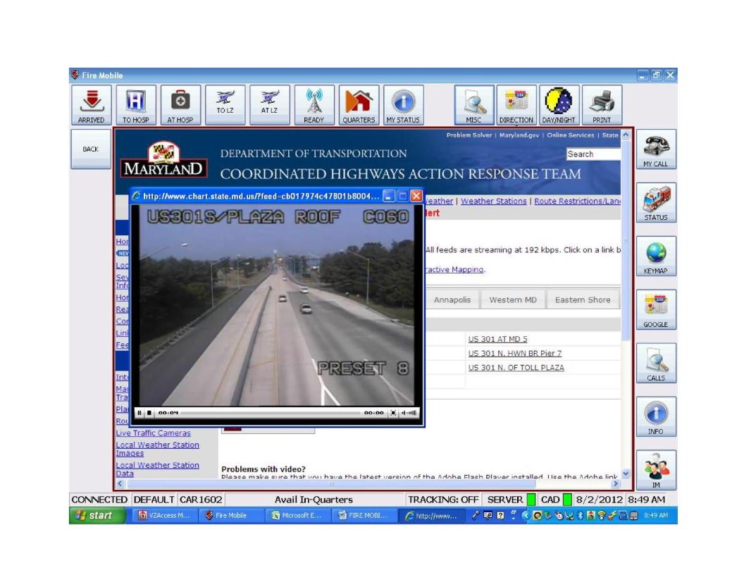

MISC Button
Example of the “TRAFFIC” button

Slide 8
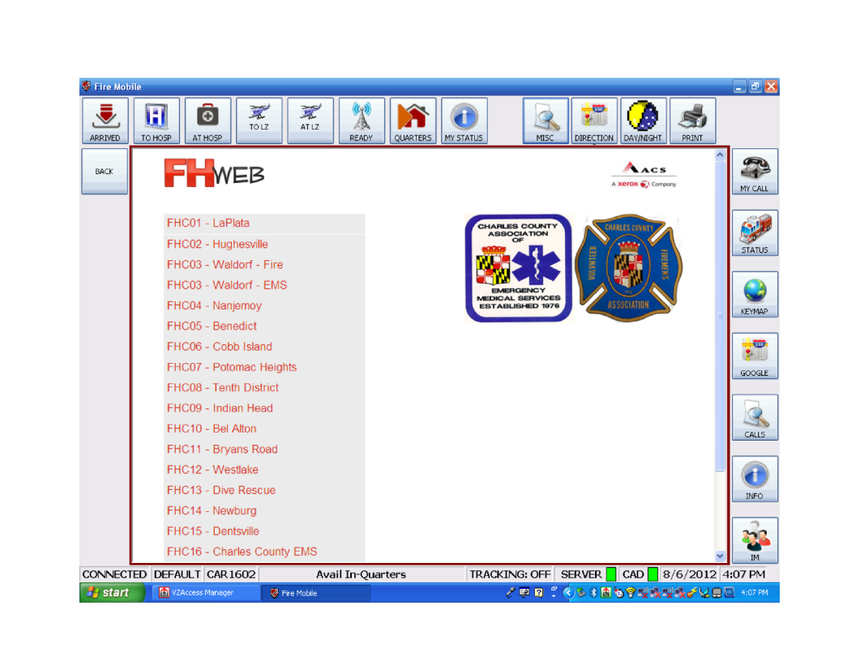

MISC Button
Example of the “FIREHOUSE” button

Slide 9
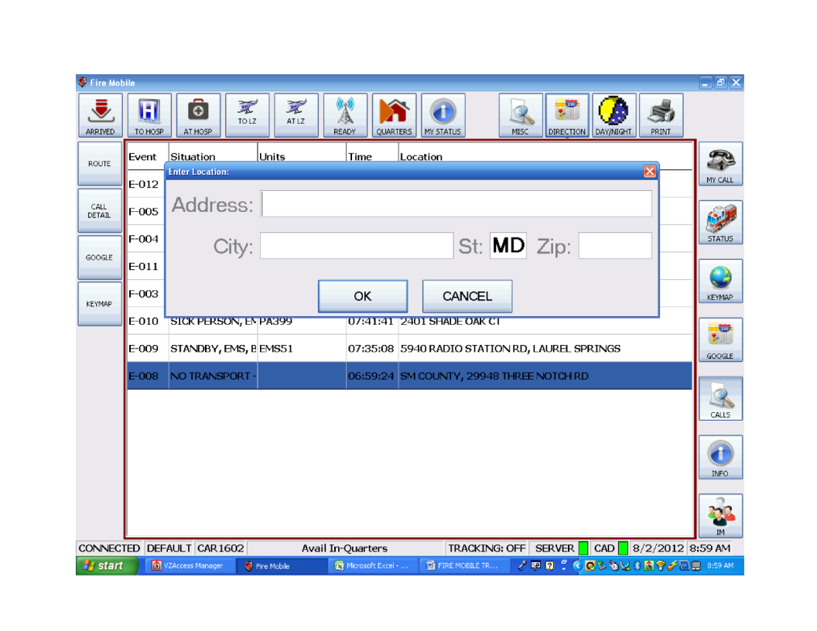

DIRECTION Button
Drag the box until you can see the address in the “Location” tab to aid in accurately typing location.
This is a Google search – Google rules apply. At a minimum, you should enter the street address and zip code.
Out of County calls cannot be automatically plotted in KeyMap or Google Map. To get a route to a mutual aid call, use the “Direction” button and type in address information.

Slide 10
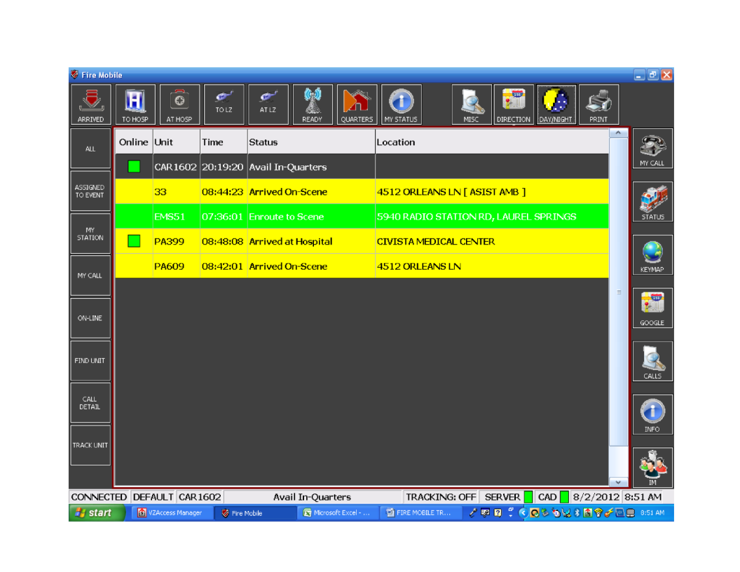
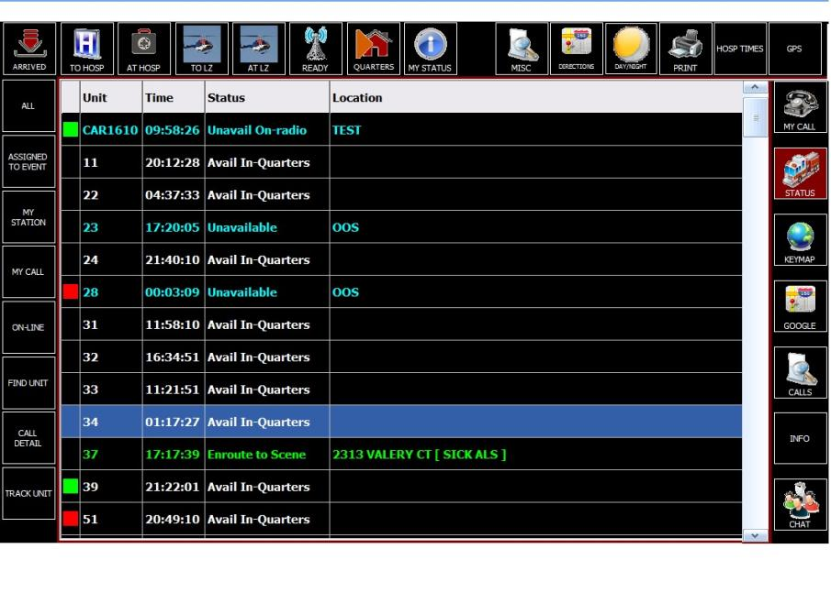

DAY/NIGHT Button
It may still be necessary to dim the computer display while using night mode. You will need to reset the computer display level when you return to day mode.

Slide 11
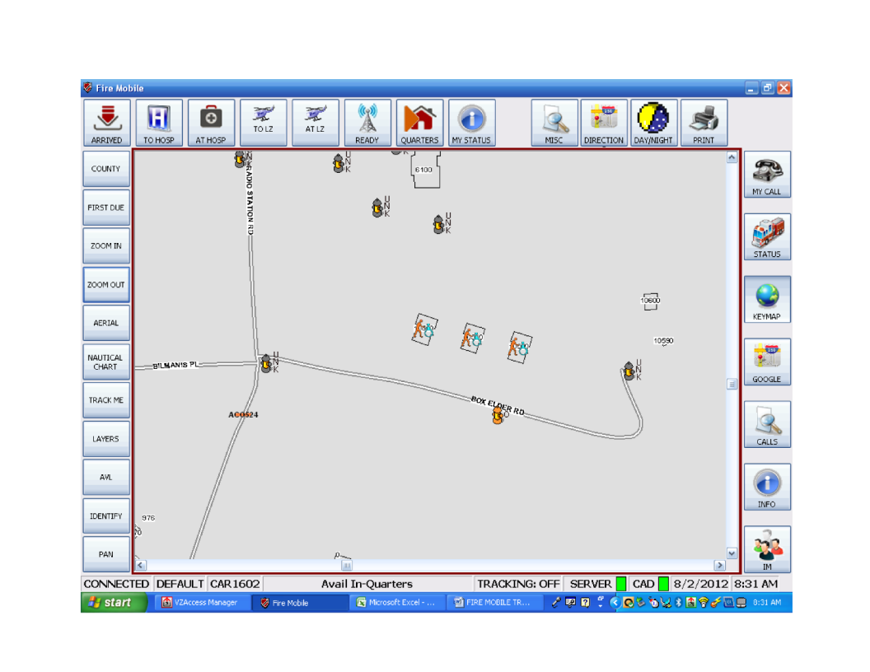


PRINT Button
Used to send the entire screen (includes menu bar at bottom of screen) to default printer.

Slide 12
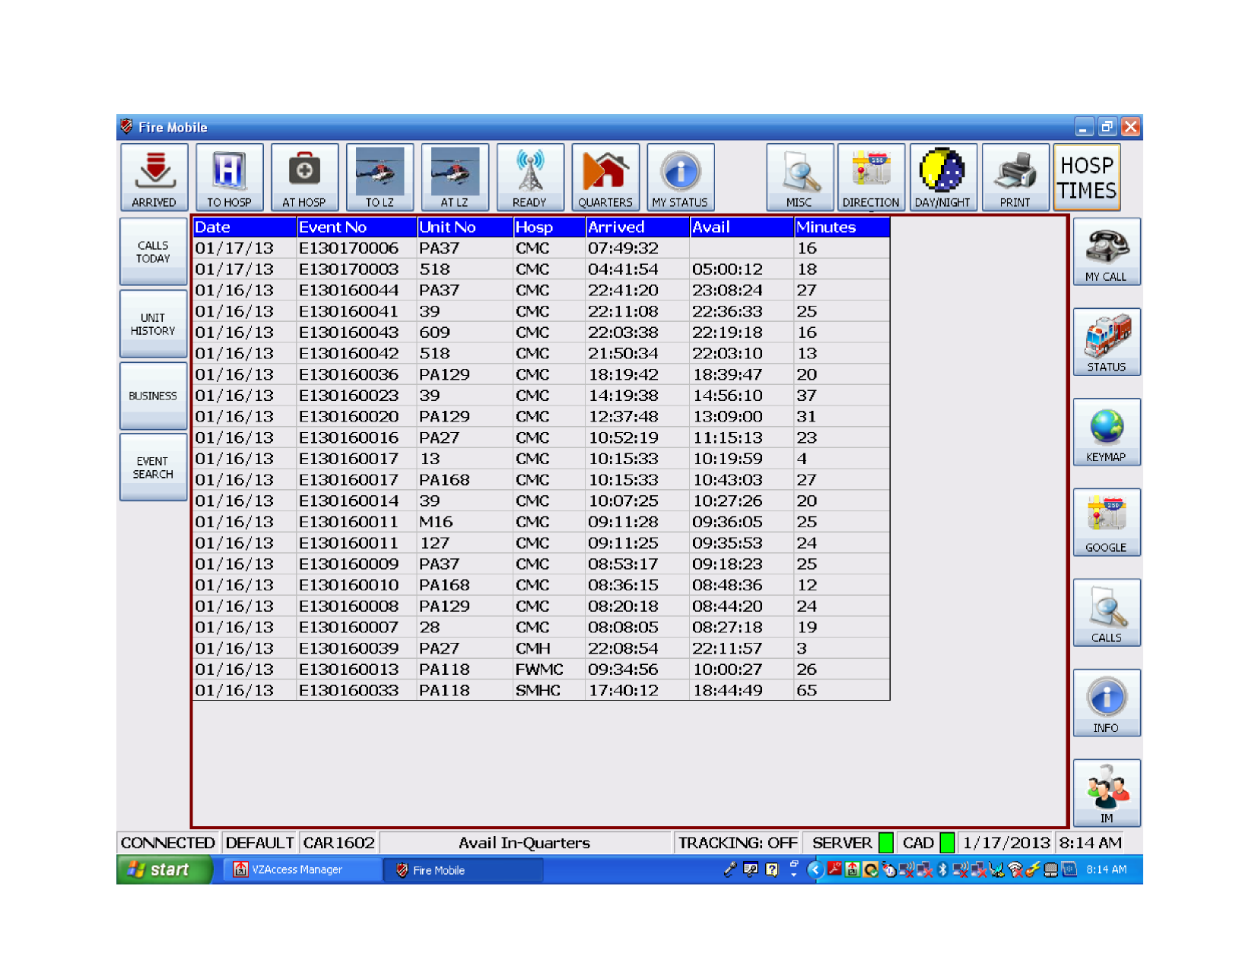


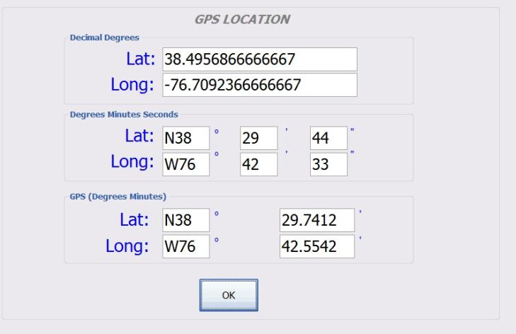
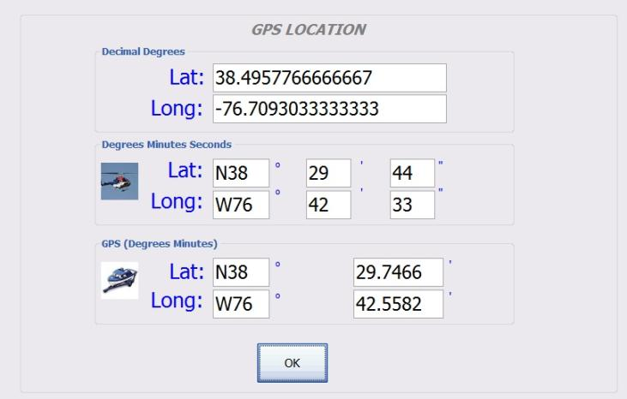
GPS Button
Coordinates displayed are for the location of this laptop. As you move, they are updated.
Indicates the preferred coordinate system for this type of responder
If your GPS is not transmitting/receiving, the coordinates will be WRONG!!

Slide 13
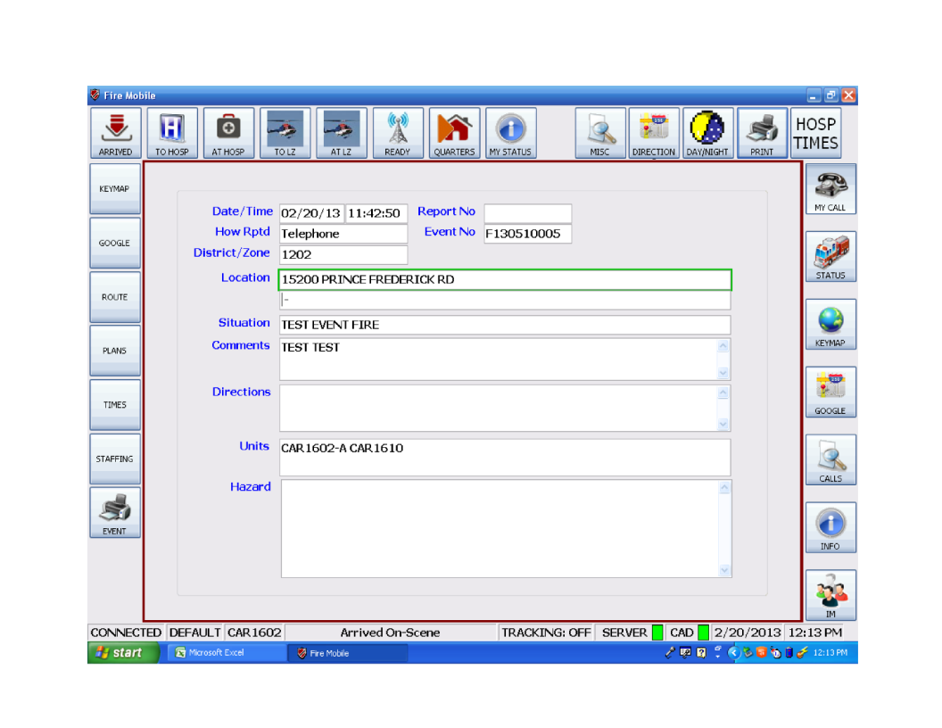

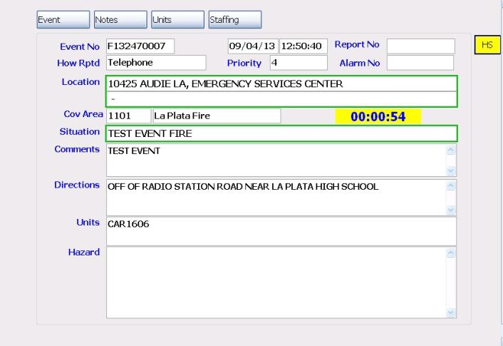
MY CALL Screen
See the event location on our map.
See the event location on Google map.
If event type warrants, a timer appears
Get route information from Google.
Print incident information
An audible alert is sounded every time a change in Situation, Location, Cause and Extent, or Comments is made.
MDT does not activate like a pager. This screen will open automatically and an audible alert is activated if the Unit/Laptop is specifically dispatched to the event or a unit is assigned to the event. Otherwise the “CALLS” button will flash yellow and an audible alert is activated.

Slide 14
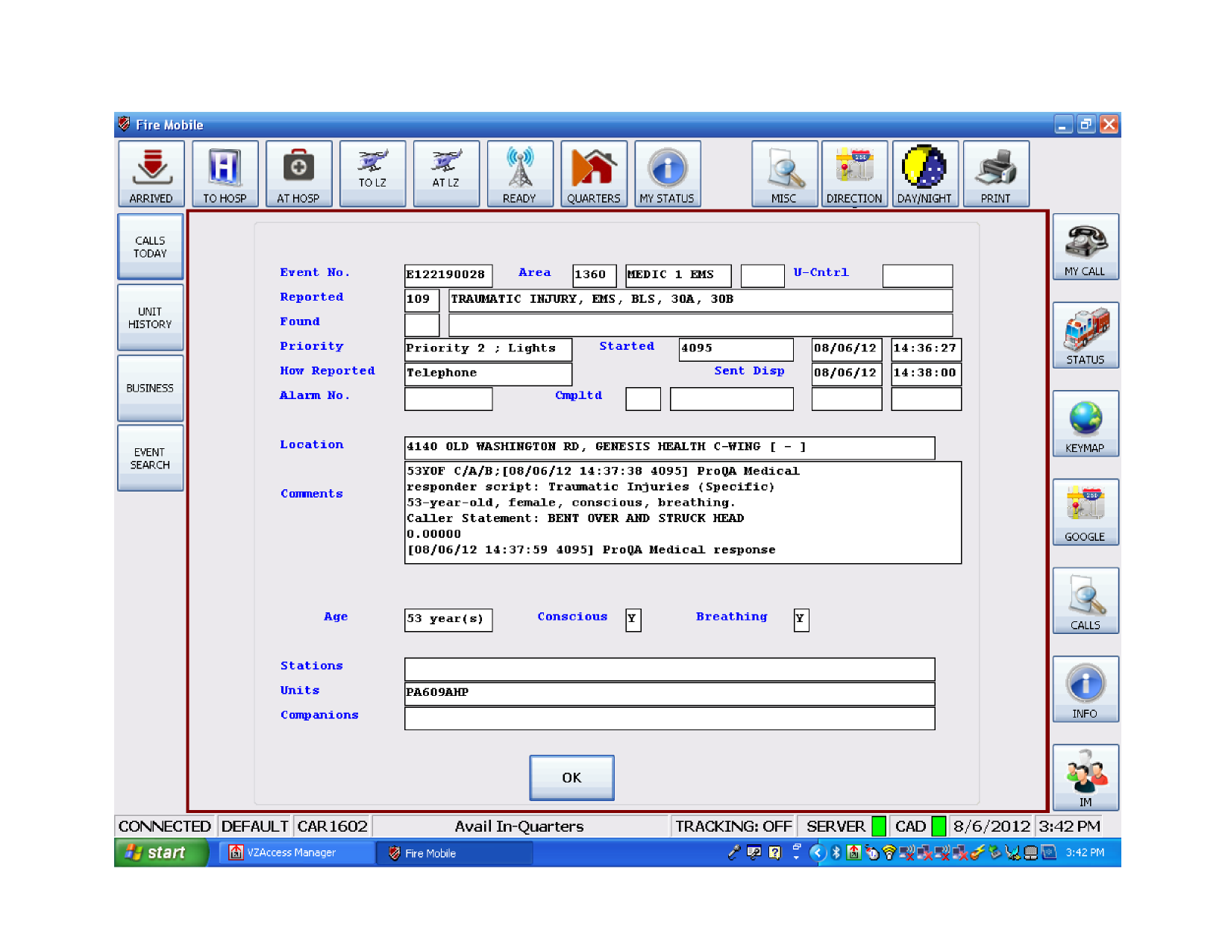

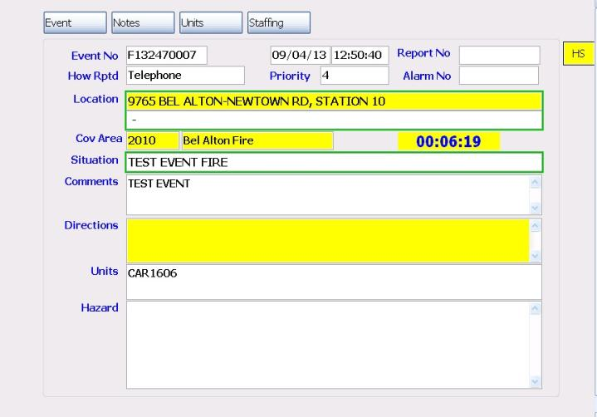
Call Details Screen
These buttons are not displayed UNLESS you are assigned to this event.
Incident #
Flashes yellow and audible alert activated if Engine or BLS is due on call
This screen is accessed from either the Status Screen (Call Detail button) or the Calls Screen (Call Detail button)

Slide 15

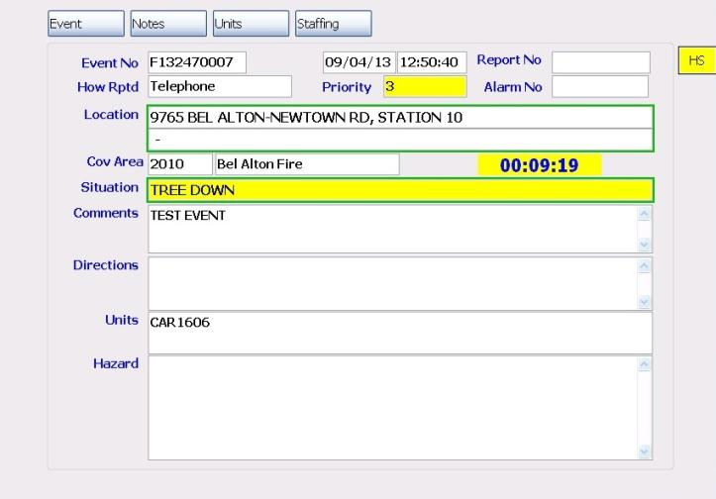
Call Details Screen
Hazard notification. Full info also displayed in the “Hazard” block.
Comments are mission critical/safety information along with EMD/EFD information.
This screen is accessed from either the My Call button, the Status Screen (Call Detail button) or the Calls Screen (Call Detail button)

Slide 16

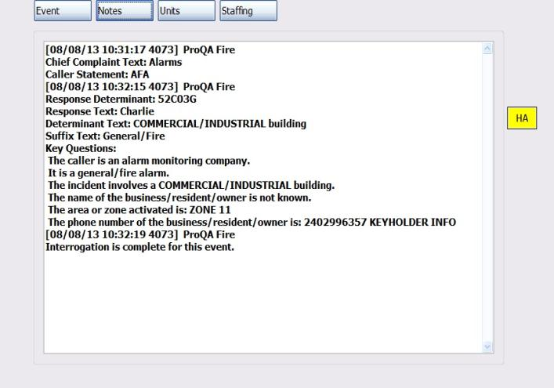
Call Details Screen – Notes Tab
Comments are abbreviated notes. Full notes are available on the “Notes” tab.
This screen is accessed from either the My Call button, the Status Screen (Call Detail button) or the Calls Screen (Call Detail button)

Slide 17

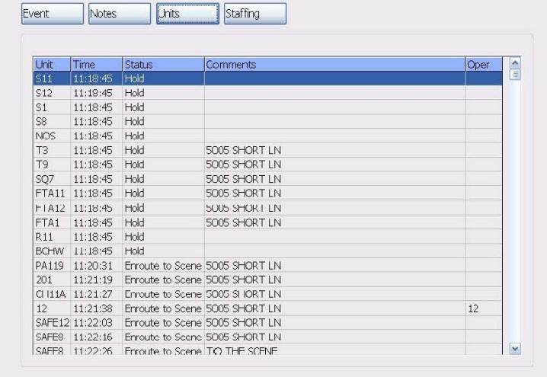
Call Details Screen – Units Tab
Pressing on any column heading will change the sort option from A-Z to Z-A.
Comments are abbreviated notes. Full notes are available on the “Notes” tab.
This screen is accessed from either the My Call button, the Status Screen (Call Detail button) or the Calls Screen (Call Detail button)

Slide 18



Call Details Screen – Units Tab
Engines are due in this order
Trucks are due in this order
Tankers are due in this order
This screen is accessed from either the My Call button, the Status Screen (Call Detail button) or the Calls Screen (Call Detail button)

Slide 19
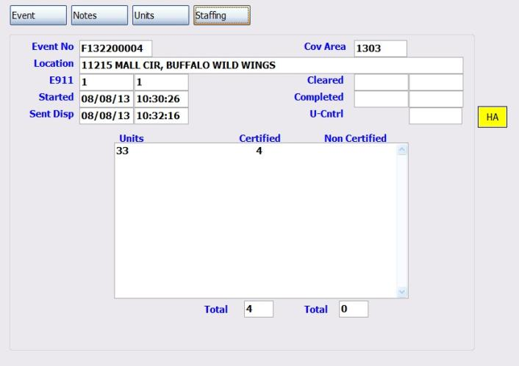
Call Details Screen – Staffing Tab
Comments are abbreviated notes. Full notes are available on the “Notes” tab.
This screen is accessed from either the My Call button, the Status Screen (Call Detail button) or the Calls Screen (Call Detail button)

Slide 20

STATUS Screen
Shows all units in the fleet
Shows all units assigned to your event.
Shows all units with MDT On
Select a unit and use this button to find it on our map.
Select a unit and use this button to access the Call Details screen.
Select a unit and use this button to track it on our map.
Assigned to Event – Shows all units assigned to any event.
My Station – Shows all units from your station. (S3 & S12 are displayed together, as are R3 and R12)

Slide 21
STATUS Screen
Pressing on any column heading will change the sort option from A-Z to Z-A. Your unit is always listed at the top.
Double clicking on a unit will initiate an IM session.
Green Inset Square = MDT On
Red Inset Square = MDT Off
No Inset Square = No MDT

Slide 22
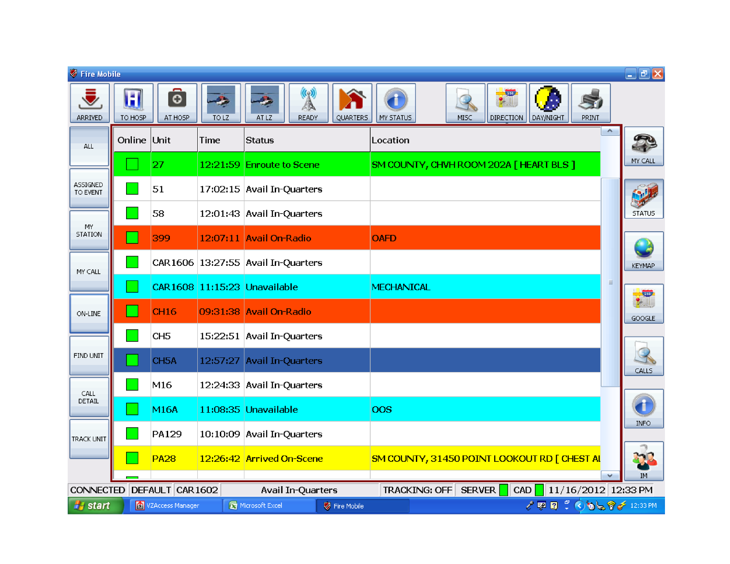
STATUS Screen
Green/Enroute
Not Shown – Red = Hold
Orange/Available
Cayan/Unavailable
Dk Blue/Selected
Clear/Avail in Qtrs
Yellow/Arrived
Every color has a meaning – every color change is a unit status change. Status colors are also indicated on the map AVL icons.

Slide 23
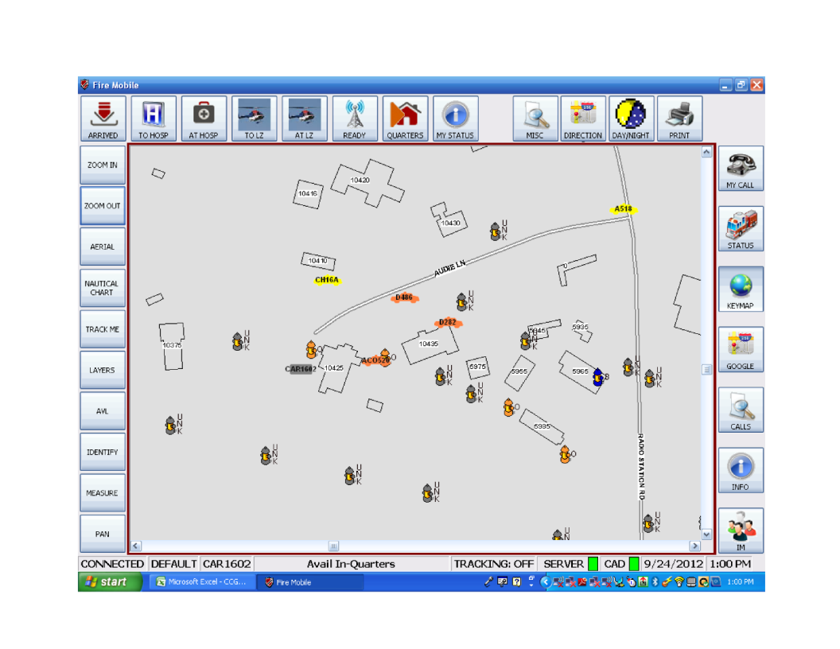
KeyMap Screen
Zooms in on center of screen (double tap on screen has same effect).
Zooms out from center of screen
Opens a secondary window with additional functions
Turns aerial photos on and off
Tracks your location. Press button again to turn tracking off.
Opens a secondary window to selectively close roads
Opens a secondary window with measurement options
Status of tracking function

Slide 24
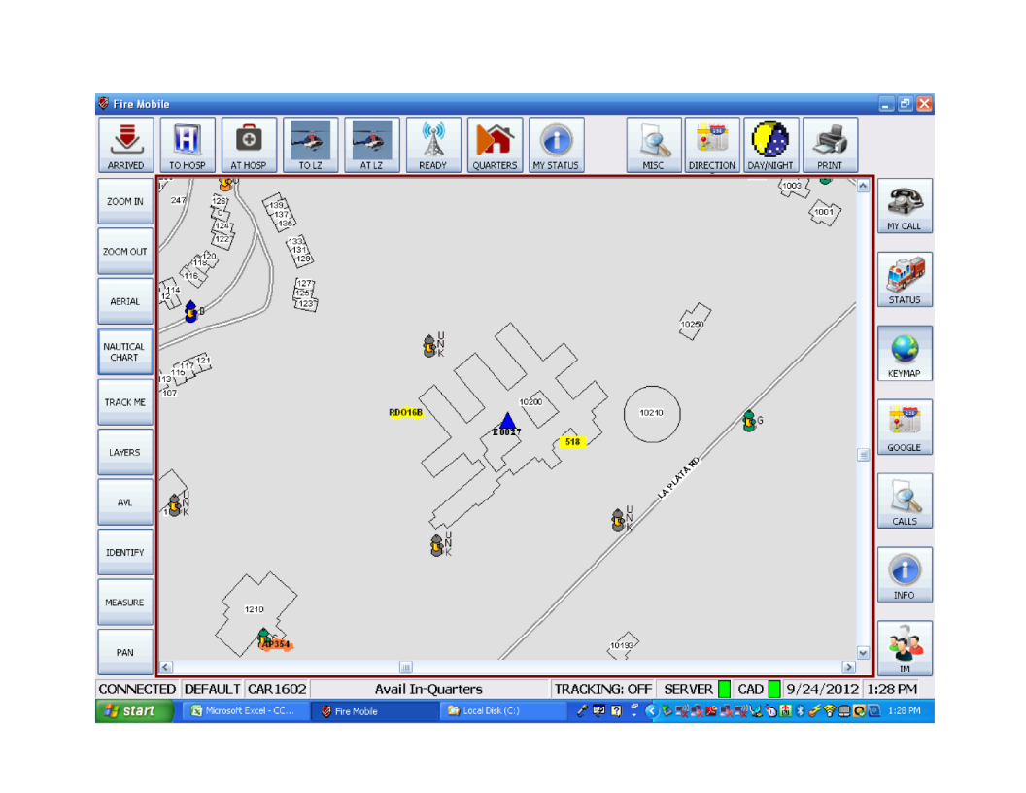


KeyMap Screen
Unit status colors match those on the Status screen
Tip: Hovering over event icons with the cursor shows event information
Event Icons
Blue = EMS
Red = Fire
Green = Police
Orange = CCG
Use KeyMap to see the position of units that are on the scene and those still responding.

Slide 25
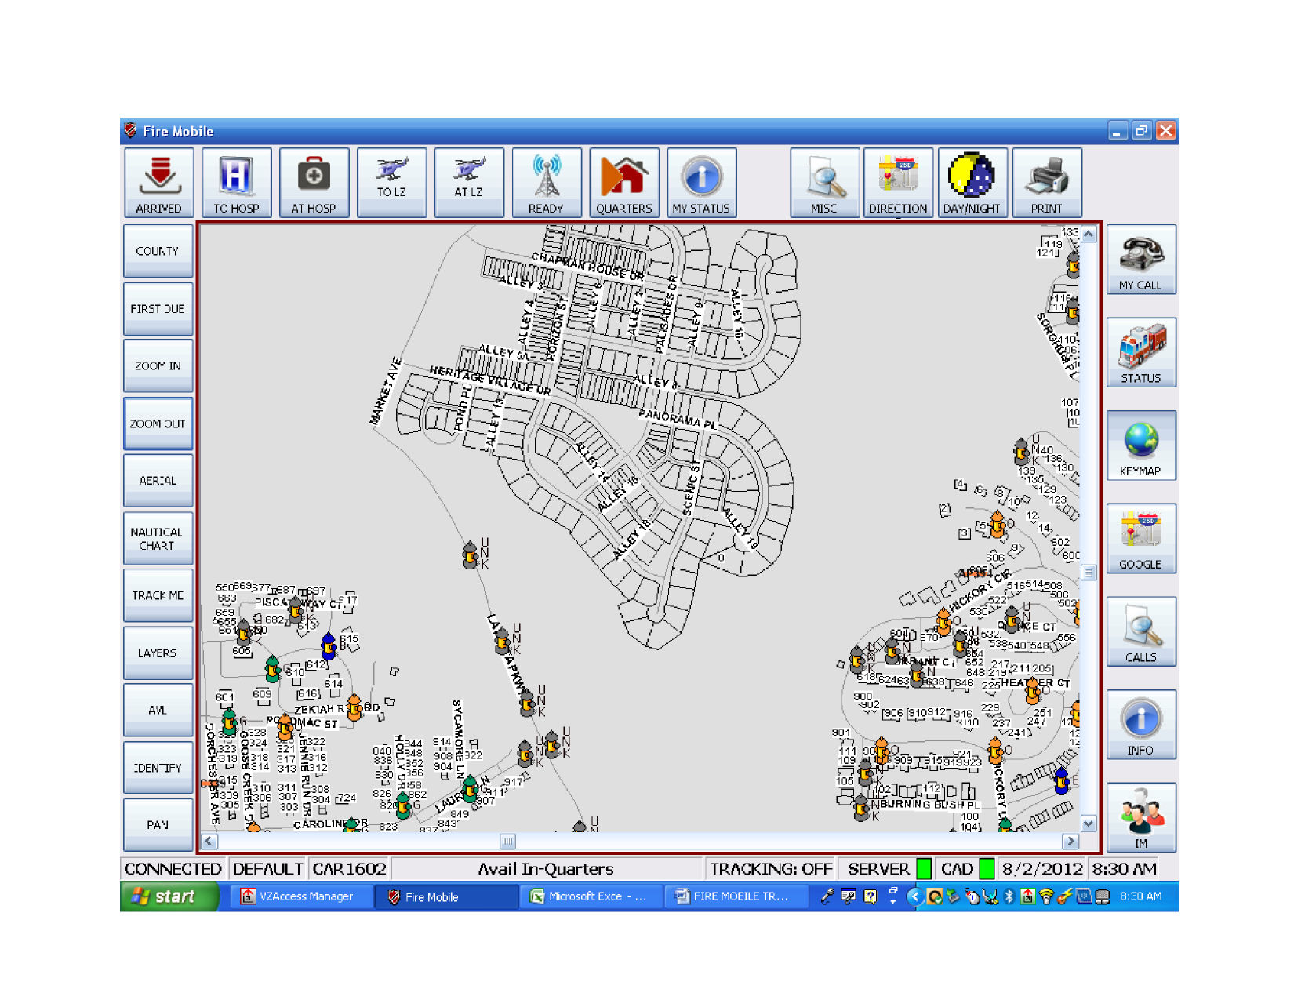
KeyMap Screen
Layer information is updated by DoES on a recurring basis.
Lots are shown on the map for new construction until updated photos are obtained.
To reduce clutter, units with a status of “Available In-Quarters” do NOT plot on the map.
As you zoom in and out, layers are turned on and off automatically. In this case we have zoomed in until hydrants and house number are visible.

Slide 26


KeyMap Screen
As you zoom in closer, other icons appear (mobility impaired, static water supplies, landing zones, and stormwater outfalls).
Hydrants also appear automatically at certain zoom levels. Hydrants are color coded in accordance with NFPA, based on information supplied by the AHJ.

Slide 27
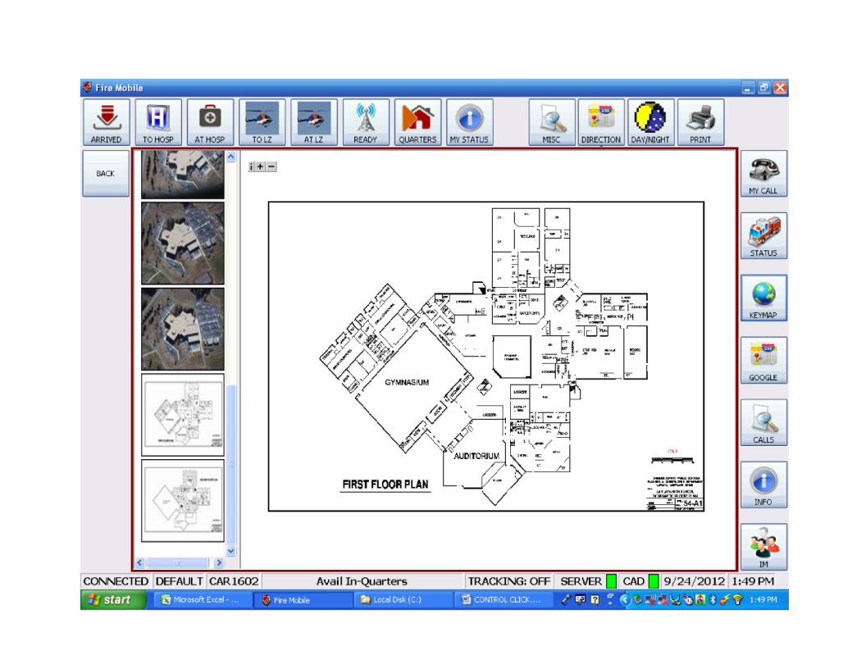

KeyMap Screen
Return to Keymap
Use slide bar to scroll through pages of additional information.
Hold down the CTRL key and click on the building that you want preplan information for.

Slide 28
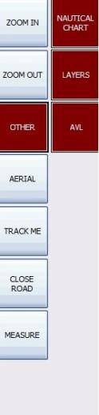
KeyMap Screen
Turns Nautical Charts on/off
Opens window that allows turning on/off layers
Turns AVL on/off

Slide 29
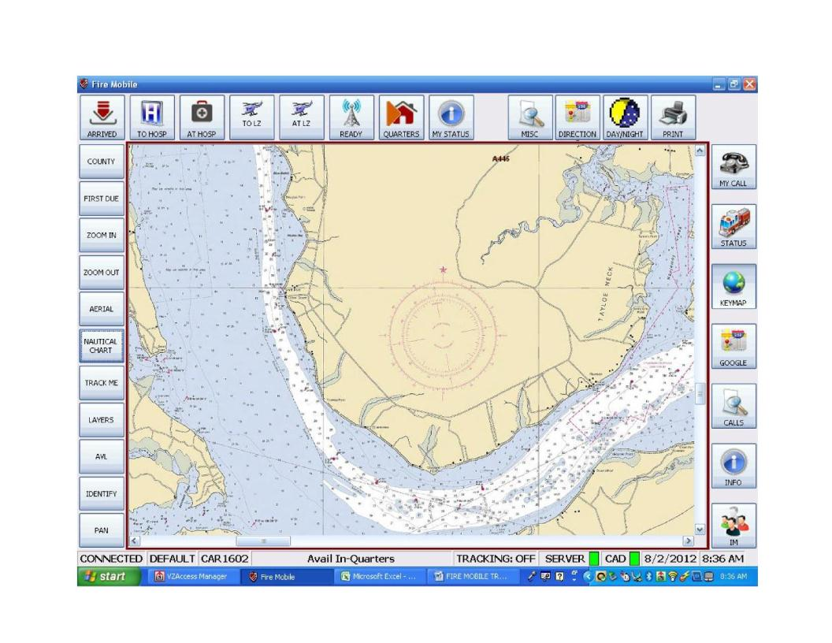


KeyMap Screen
Nautical Chart turned on.

Slide 30
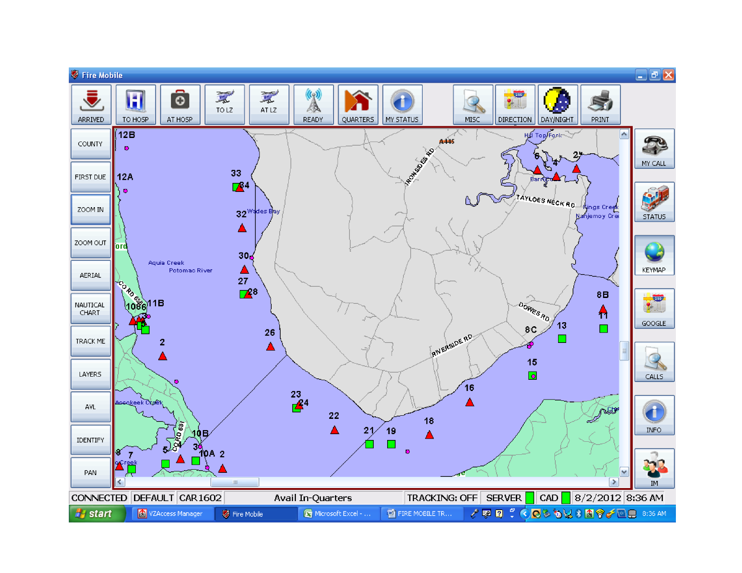


KeyMap Screen
There are multiple layers that can be manually turned on or off. The displayed layer contains the location of buoys. Info obtained from the USCG.

Slide 31
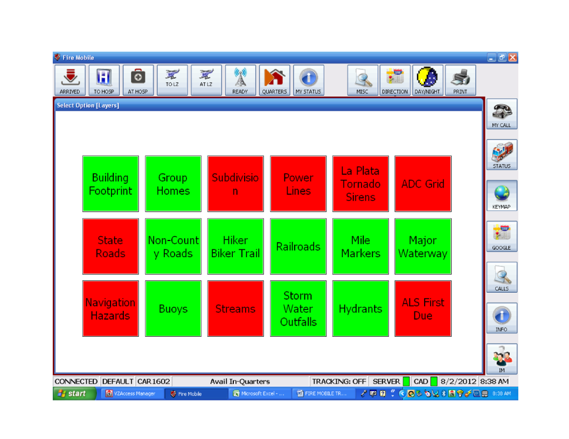
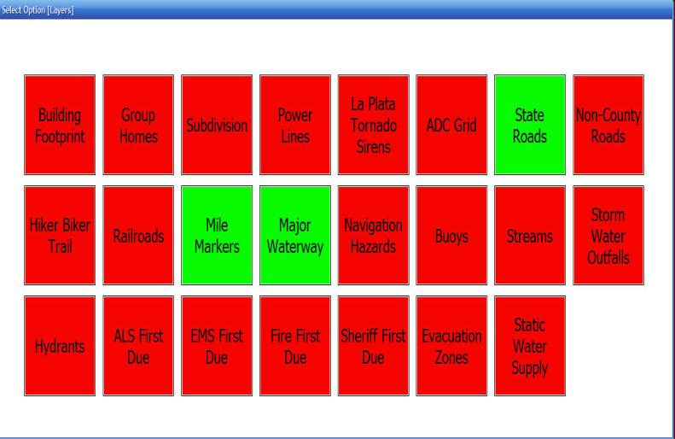
KeyMap Screen (Layers button)
Use these buttons to toggle layers on and off
Green = layer is on
Red = layer is off
Most layers turn on and off automatically. You can also manually turn on/off select layers. Some layers cannot be turned on when zoomed out past a defined point.

Slide 32
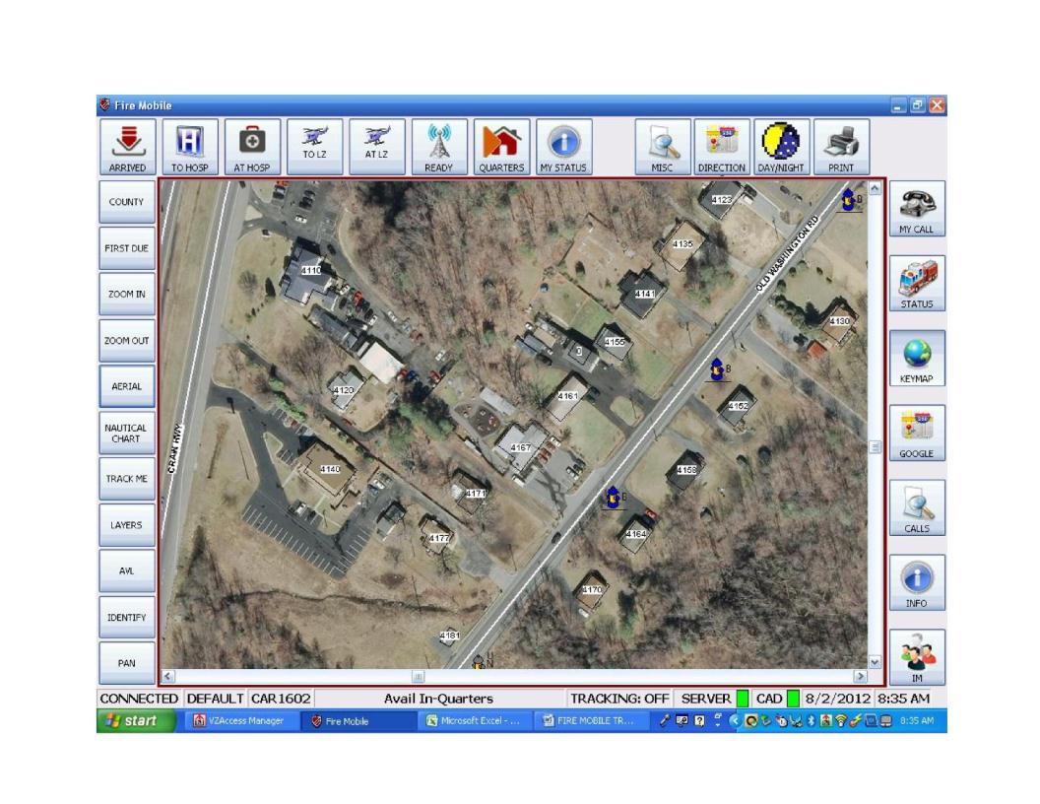


KeyMap Screen
Aerial photos can be turned on at any time – but we suggest you wait until you are near your destination.

Slide 33
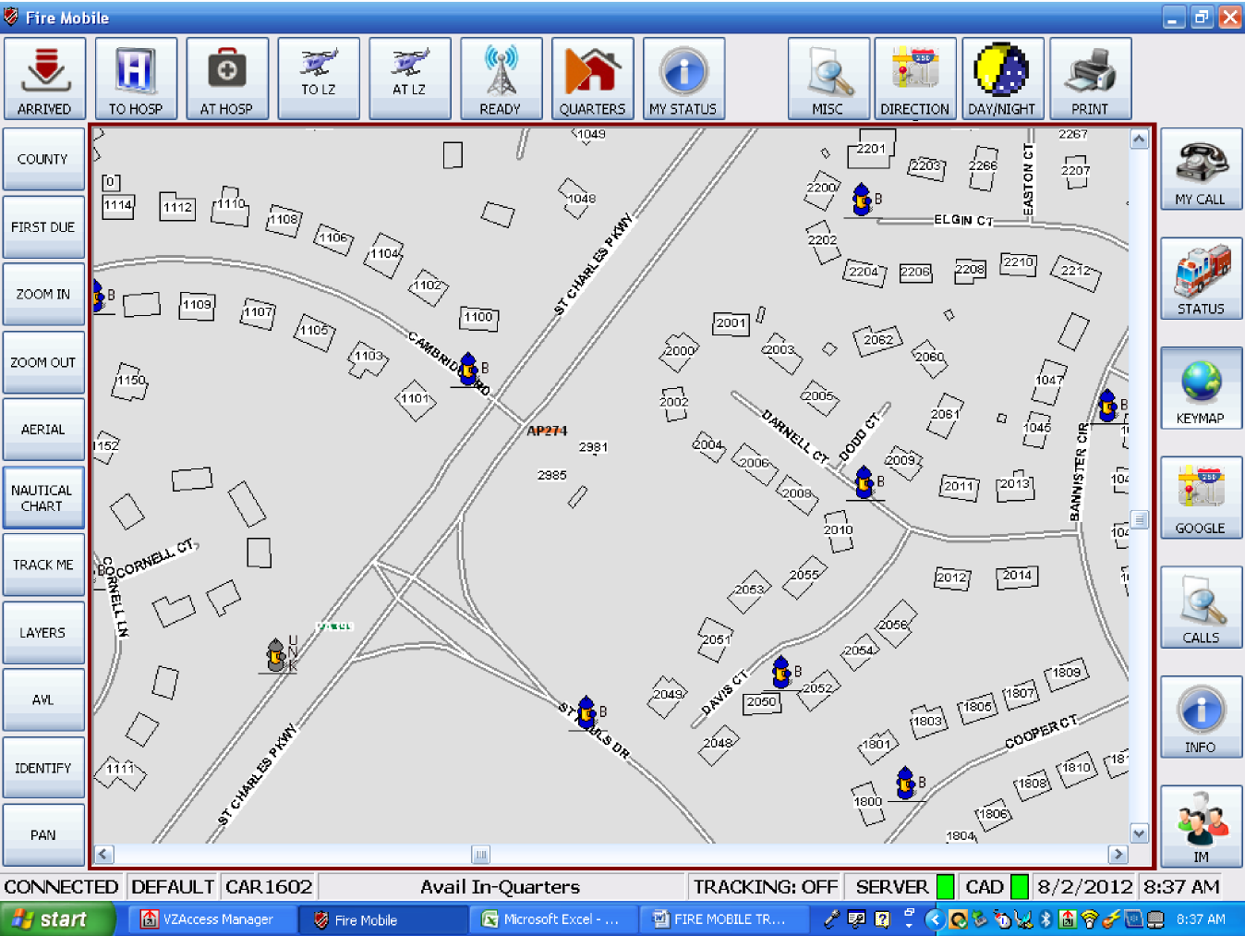


KeyMap Screen
Status of tracking function
Track Me button turns tracking on and off. If you are tracking another unit and want to stop, you can hit this button to track yourself, then hit it again to turn tracking off. Use zoom in and out to either get more detail or less clutter.

Slide 34
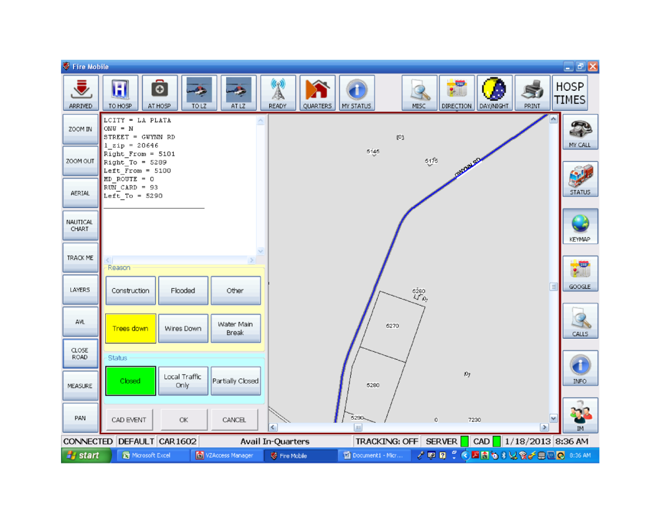

KeyMap Screen
To close a road:
Right click on the road segment(s)
Choose a reason for the closure
Choose a status
Choose OK to close the road(s); choose CAD EVENT to close the road(s) and start a call; Choose CANCEL to remove all selected road segment(s).
This window displays each road segment that has been selected. If you select a segment in error, you can either right click that segment again to remove it, or press the “Cancel” button at the bottom of the panel.
Road selection can be touchy! If you miss the segment, you will get a “Try Again” message.
Only the dispatcher can reopen or change the status of a closed road.

Slide 35
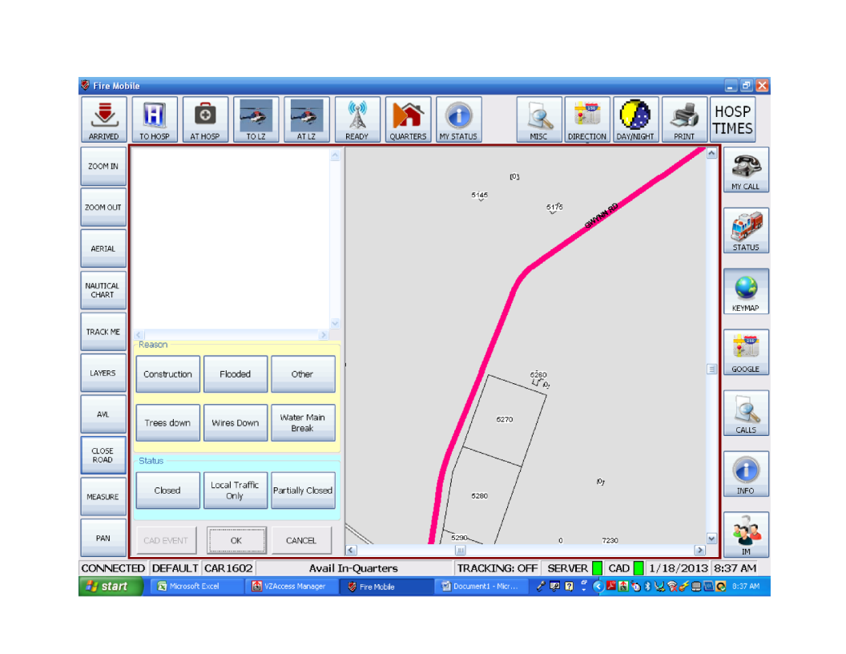


KeyMap Screen
Solid Bright Pink = Completely Closed
Dashed Medium Pink = Partially Closed
Dotted Light Pink = Local Traffic Only
Dispatchers can schedule a road closure. Scheduled closures appear in yellow until they actually close – then they turn pink as previously described.
Road segment changes color and style depending on closure status.

Slide 36
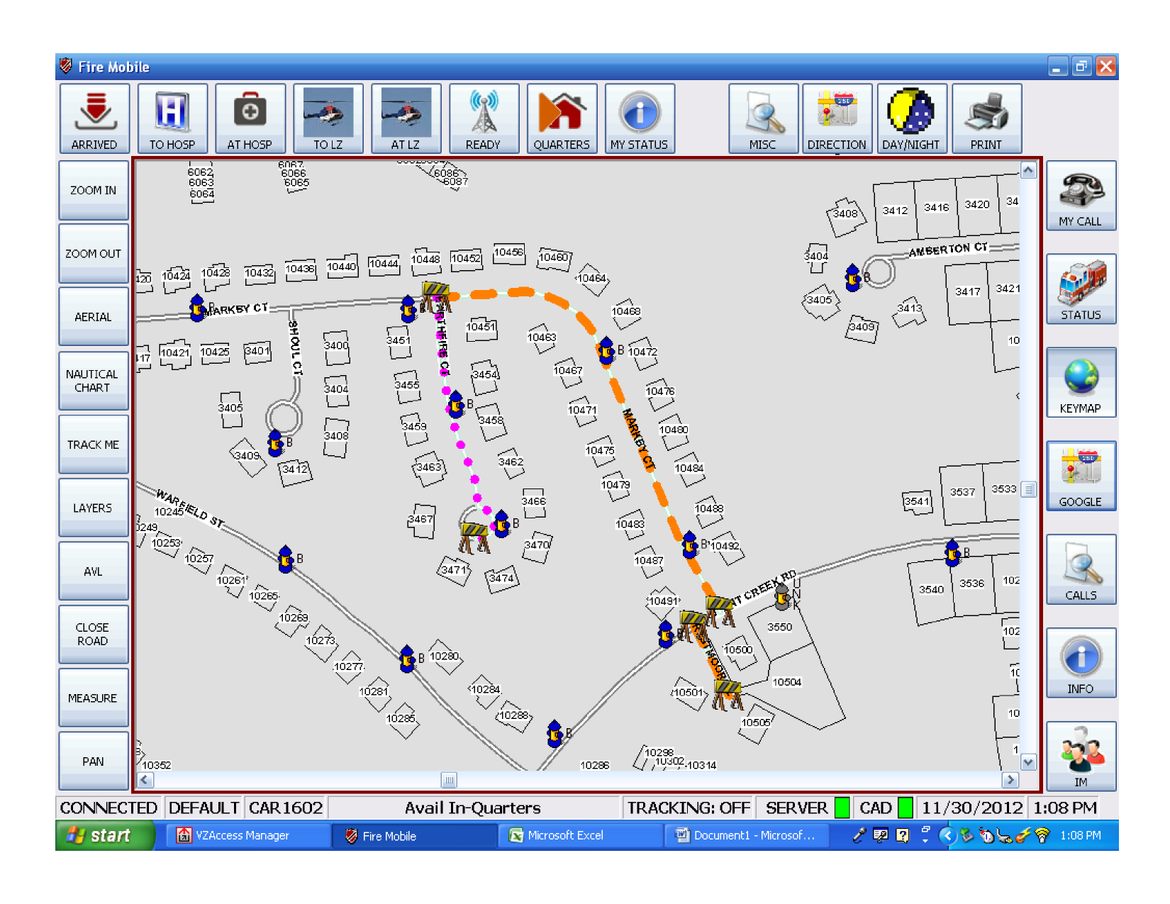

KeyMap Screen
As you zoom in, barricades are shown at each end of the segment(s) that are closed.

Slide 37
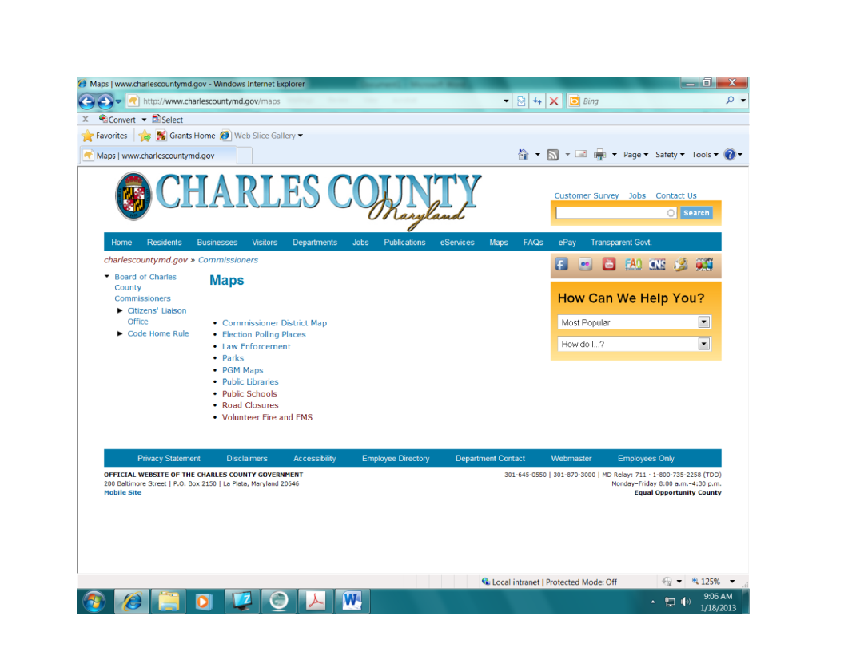
CCG Website – Road Closure
In addition to populating the MDT maps and Communications maps, the CLOSE ROAD function also sends the information to a CCG website for public consumption.

Slide 38
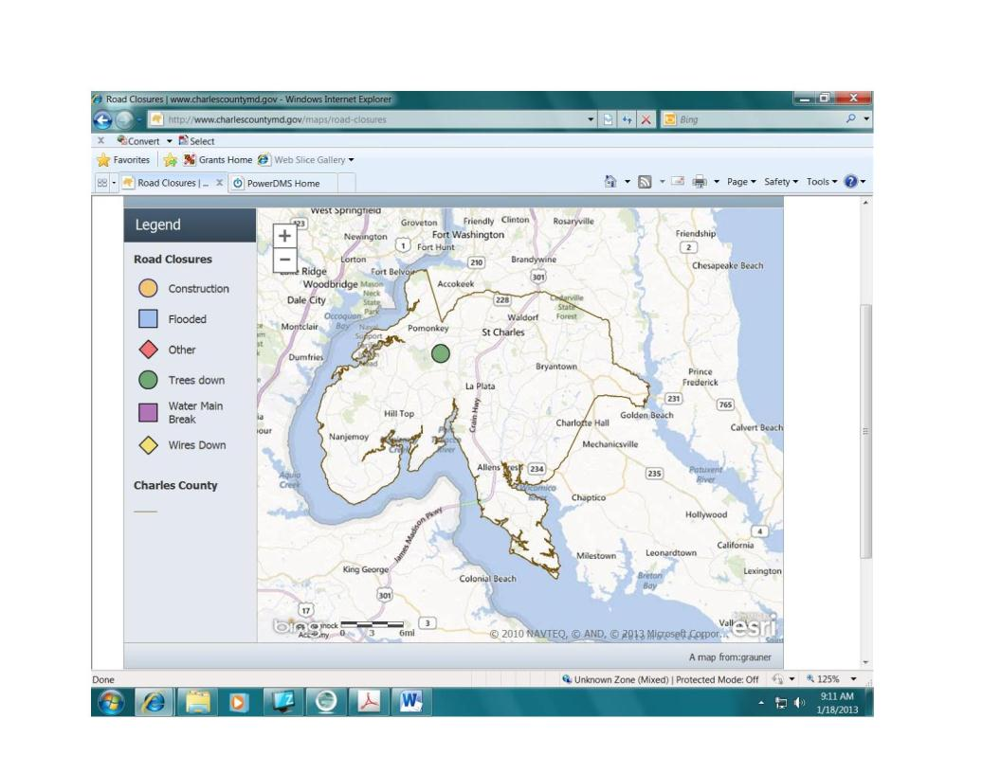
CCG Website – Road Closure

Slide 39
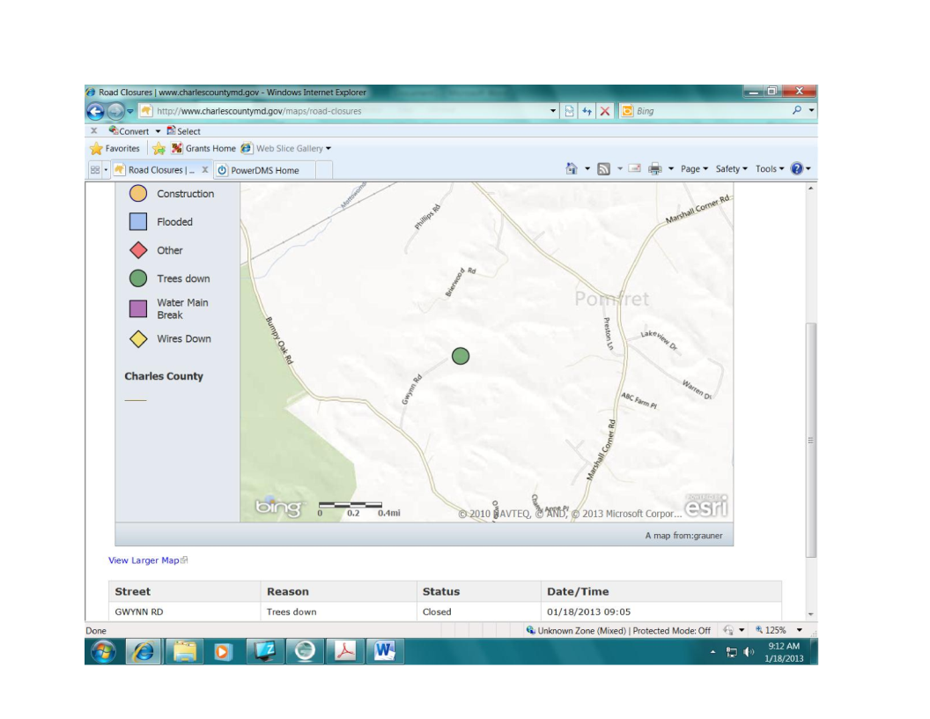
CCG Website – Road Closure
Zoom in or out to see more/less detail. As with Google maps, the road closure website does not use our locally produced maps.
List of Closed Streets

Slide 40
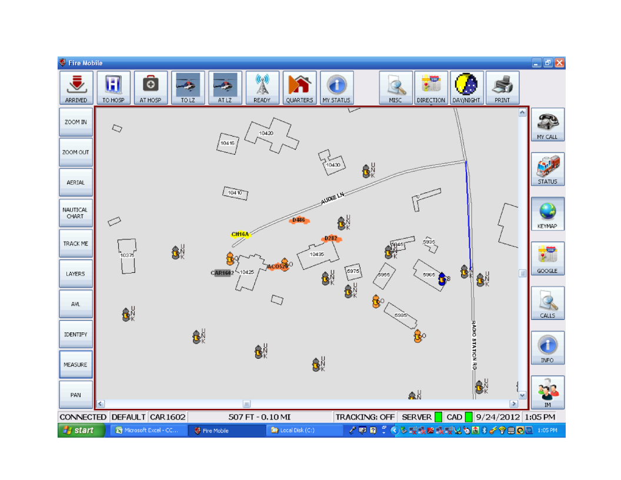
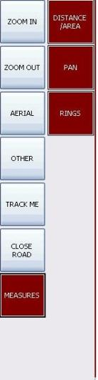

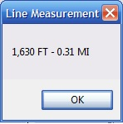
KeyMap Screen
Use “Distance/Area” to measure the distance between objects (as the crow flies) or the area of a drawn polygon
For Distance: Press on “Line” button, then use left click to start, drag the mouse to the finish point and release.

Slide 41
KeyMap Screen
Opens a new panel where you can create up to 3 customizable distance rings around a user defined point.
For Area: Press on “Polygon” button, then use left click to anchor each direction change.
The“Pan” Button is used to return the cursor from “Measure” mode back to normal map navigation.

Slide 42
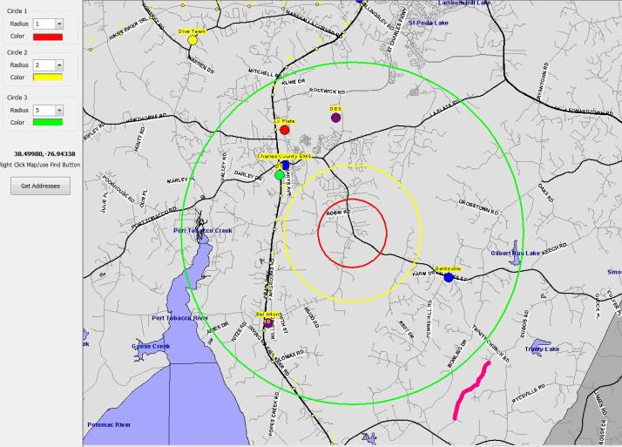
KeyMap Screen
Define ring radius distances (1-100 miles).
Select the point of origin (center of the rings) by right clicking on the map.
The Get Addresses button will generate a report of all street segments that are within the RED circle ONLY.

Slide 43
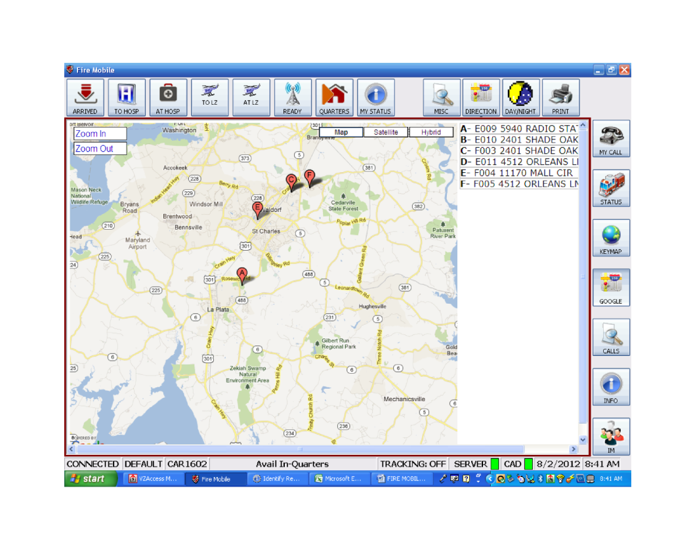
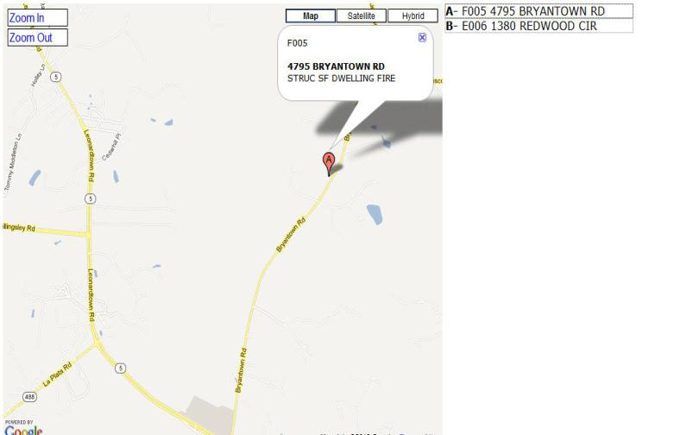

List of current events
Using the Google Button automatically plots the location of all current IN COUNTY events on Google Map.

Slide 44
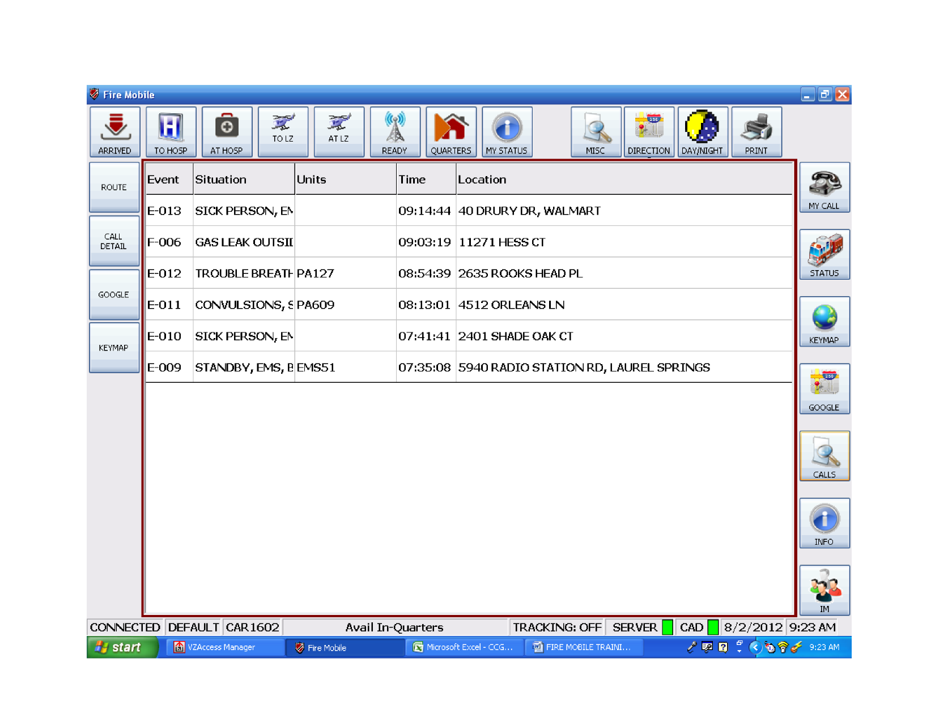
CALLS Screen
Get Google route information
See call details
See location on Google Maps
See location on our map
“Calls” button gives you a list of active calls. It flashes yellow and an audible alert is activated if your Engine or BLS is due on the call and also every time a station/unit is added to the event.
Before pressing any of the left hand buttons, you must first select an event by clicking on it.

Slide 45
CALLS Screen
Pressing on any column heading will change the sort option from A-Z to Z-A
It’s possible for a call to be listed on the Calls screen that has not been dispatched yet.

Slide 46
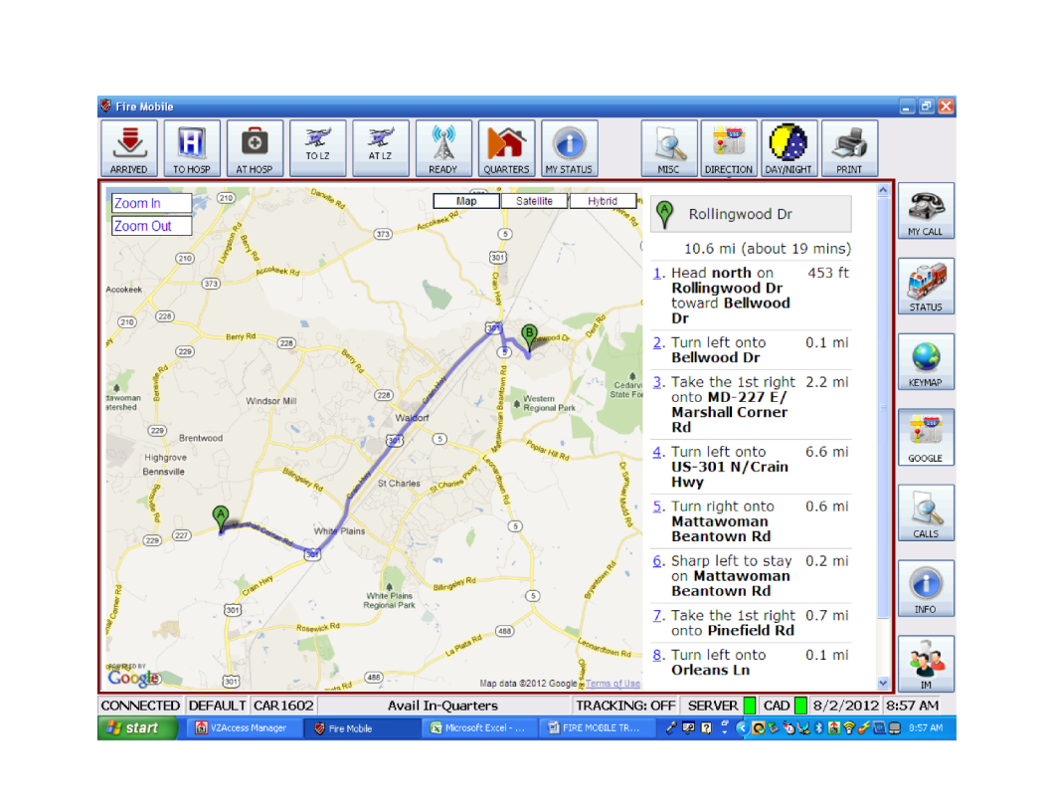

Google Route
This is the Google Map website. Zoom, pan, and other standard functions work as they normally do on the internet.
Caution! Google maps/routes are not always correct or show most recent data.
Access this screen from either the CALLS screen (Google button), My Calls screen, or the Directions button. Displays a route from your MDT location to the selected event/location.

Slide 47
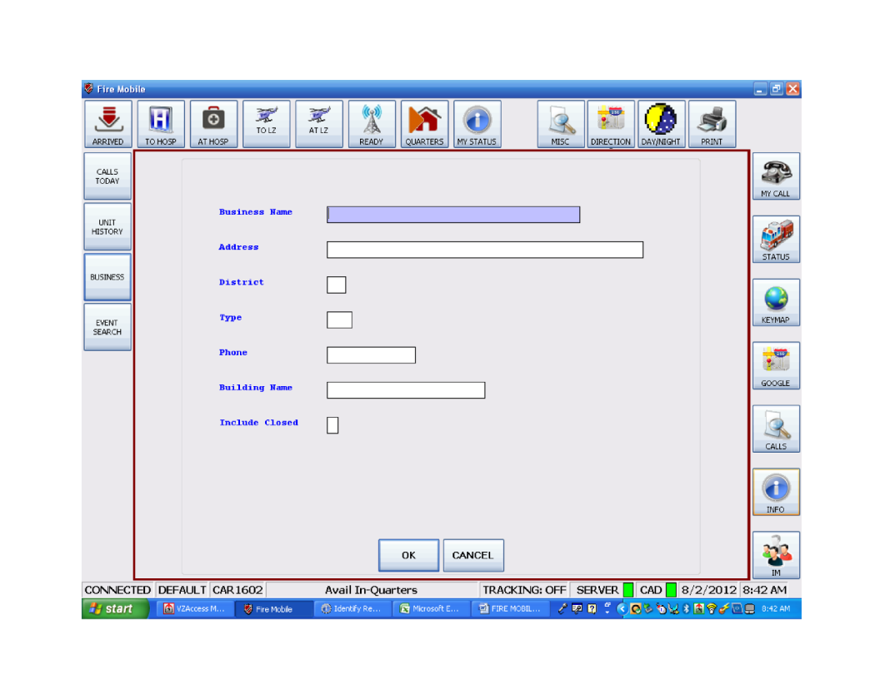

INFO Button
Navigate backwards during searches
Get a list of calls today for this unit
Get status change history for the day for this unit
These items are processed through a web application and a secure server. Getting a connection may take longer than you expect. Be patient.
Initiate a user defined business search
Initiate a user defined event search
View report showing past 24 hours “At hosp time”

Slide 48

Unit History
Pressing on any column heading will change the sort option from A-Z to Z-A.

Slide 49

Business Search
Click on link to display selected business.

Slide 50

Business Search

Slide 51




Event Search
You may enter as much or as little information as you need/know. Keep in mind that if you are too vague, or use an extended start/stop date, it may take a long time to return results.
Magnifying glasses provide a lookup of available values.
Hit Search to retrieve results.
Hit Reset to start entering information for a new search.

Slide 52

Event Search
Click on link to display selected event information.

Slide 53

Event Search

Slide 54



Hospital Transport History Report
Units that are currently at a hospital are listed at the top of the report. They have no “AVAIL” time.
This is a list of units that have been at a hospital in the last 24 hours; sorted by hospital, then starting with the most recent. To update the elapsed time, press the “HOSP TIMES” button again.

Slide 55

Hospital Transport History Report
Date and time must be kept accurate.

Slide 56


IM Screen
Select the unit(s) you want to send a message to
Clears the Message Screen
Sends message to all MDT’s currently online
This button is being deleted.
Sends message to all MDT’s from your station that are online
Units that have been chosen to receive the message
Type your message here. Do not use the <enter> key in your text.
Press to send message

Slide 57

Emergency Message from Communications
Communications can send an emergency message to every MDT that is online. The message stays on your screen until you press the OK button.
Examples of use are: Radio system failure, Comm Center evacuation, imminent severe weather alert, Emergency actions, etc.

